Slide 1

CONSUMER COMMERCE ANALYSIS
AP21110011421-siddharth
AP21110011437-srinadh
AP21110011537-lakshmipathi

Slide 2

Abstract
​
Retention Strategies: Identify key factors leading to customer churn enabling businesses to implement targeted retention strategies and reduce customer attrition.​
Personalization: Tailor marketing efforts and customer experiences​ based on data insights, leading to more personalized interactions and ​ improved customer satisfaction.​
Cost Savings: Reduce acquisition costs by focusing on retaining ​ existing customers, leading to improved profitability and resource optimization.​
Competitive Edge: Gain a competitive advantage by using data-driven ​ insights to make informed decisions, stand out in the market, and ​improve overall business performance.​
​ ​

Slide 3

Introduction
This data analysis delves into e-commerce dataset about-
How various factors affect the purchasing of different products.
Identify our target audience.
Where customers discontinue their association with an online store.
Uncover crucial churn drivers
By exploring historical customer data ,the findings aim to empower e-commerce businesses with data-driven insights to enhance customer loyalty and thrive in the competitive digital landscape.

Slide 4
Libraries Used
Pandas- Used to manipulate and analysis of the data
Matplotlib - Creating static, animated, and interactive visualizations in Python
Seaborn - Library that uses Matplotlib underneath to plot graphs. Majorly, to visualize random distributions.
Scikit-learn - Open-source machine learning library for Python, used for data preprocessing.

Slide 5

Common Queries
Which category saw the highest growth in orders from last year?
Who is more like to churn, male or female?
Which mode of payment gives highest cashback?
City Tier wise distribution of the number of orders received?

Slide 6
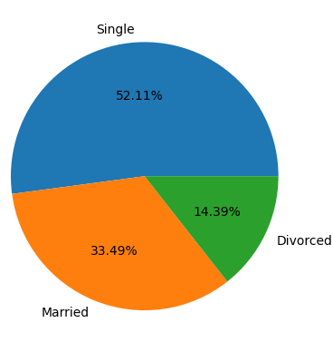
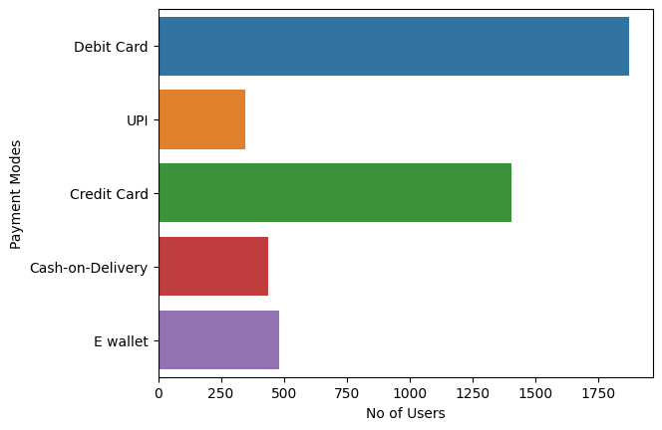
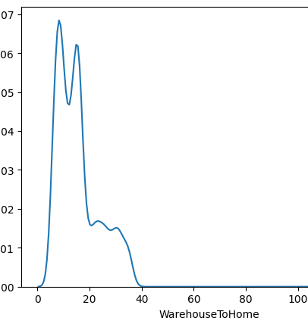
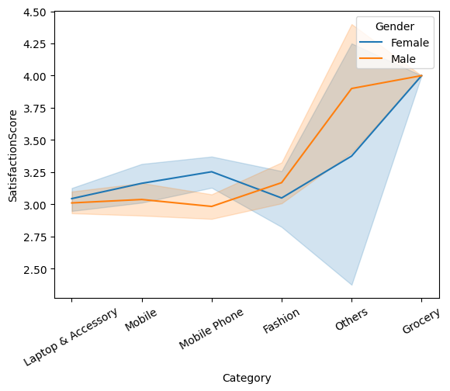
Few Graphs

Slide 7

System requirements
Software Requirements:
Python (latest version): Serves as the primary programming language for data analysis, and in utilizing multiple libraries. (Preferably use, Jupyter Notebook)
Hardware Requirements:
Processor: Multicore processor with at least 2.5 GHz clock speed (recommended: 4 cores or more)
RAM: Minimum 8 GB (recommended: 16 GB or more) for handling large datasets and memory-intensive operations.
Storage: Adequate storage space for storing the dataset and analysis results

Slide 8

Conclusion
Churn Drivers Identified: Through data analysis, key factors influencing customer churn have been identified, including poor satisfaction score, and infrequent purchases.
Data-Driven Decision Making: Understanding customer behavior and optimizing business performance in the competitive e-commerce landscape.
Business Growth Opportunities: By proactively addressing churn and enhancing customer retention, the analysis project opens up opportunities for sustainable business growth, increased profitability, and long-term success in the e-commerce industry.

